Slide 1
Time Manager
Keeping track of your clonsultants

Slide 2
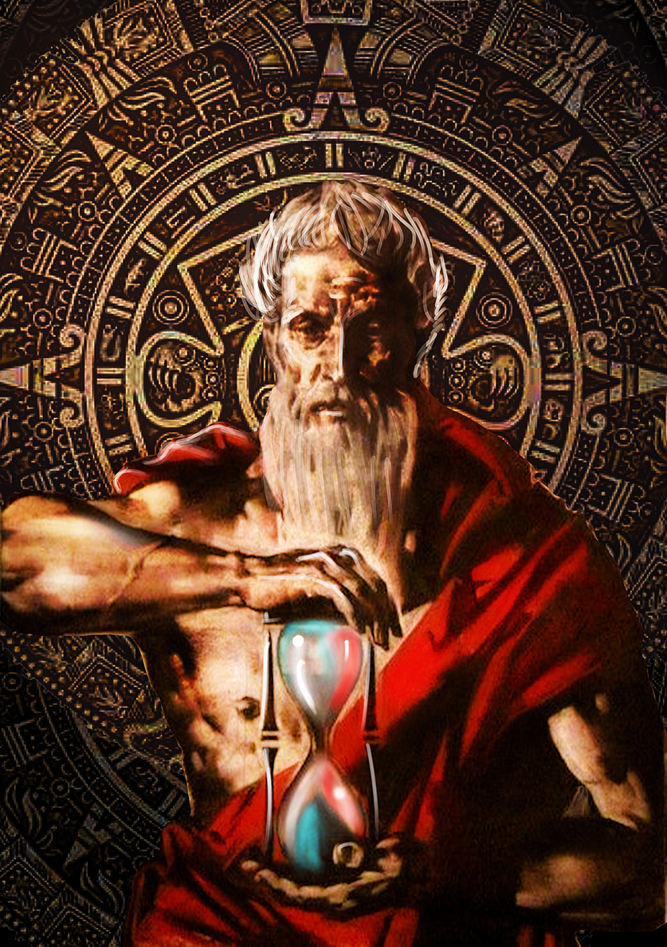
Who we are !
The unaging Chronos was "engendered" by "earth and water", and produced the egg gave birth to the first generation of Greek gods and is the ultimate creator of the cosmos!
We’re following the same appraoch
New Dynamic Company
Perth based / Local Support
Long history of delivering products
Best technical resources in the City
Full life cycle of product

Slide 3
Our Crack Team of Developers
Miles Flavel
CTO
Gabriela Pizo
CMO
Dhrutika Rathod
CEO
Rollend Xavier
CIO
Richard Greene
HR

Slide 4
Our Approach
React
Present
Process
Integrate multi source data

Slide 5
We understand your requirements
Consultants need to know where they are for the next 2 months
Managers want to see all the consultants at a specific client
Managers want a summary of total days per consultant and team at the client
Managers would like a way to receive updates from a consultant if the schedule is wrong
Managers would like to highlight Australia/India public holidays
Bonus points for extra features/functionality

Slide 6
Conclusion
We have the team
We have the talent
We have the process

